Slide 1



Python MVC
By Bence Mágori

Slide 2
Agenda
What is MVC?
Webframes to consider using
Example
Sources

Slide 3
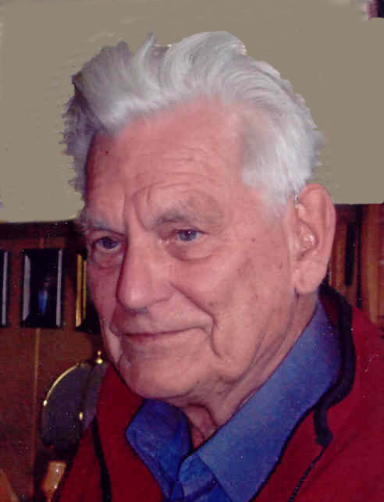
What is MVC?
Trygve Mikkjel Heyerdahl Reenskaug

Slide 4

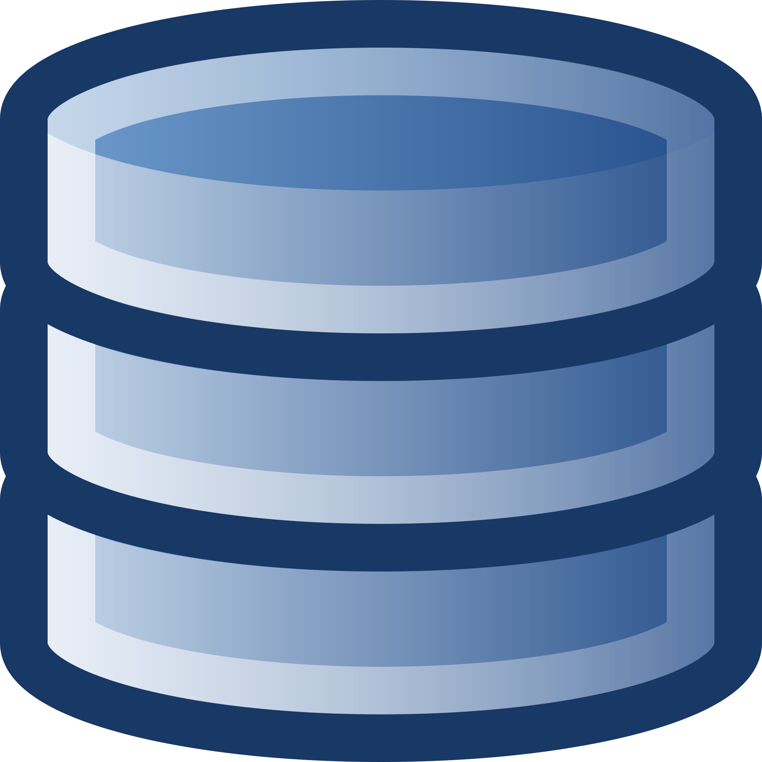
What is MVC?
User
Request
Controller
Response
Presentation
Data
View
Model

Slide 5
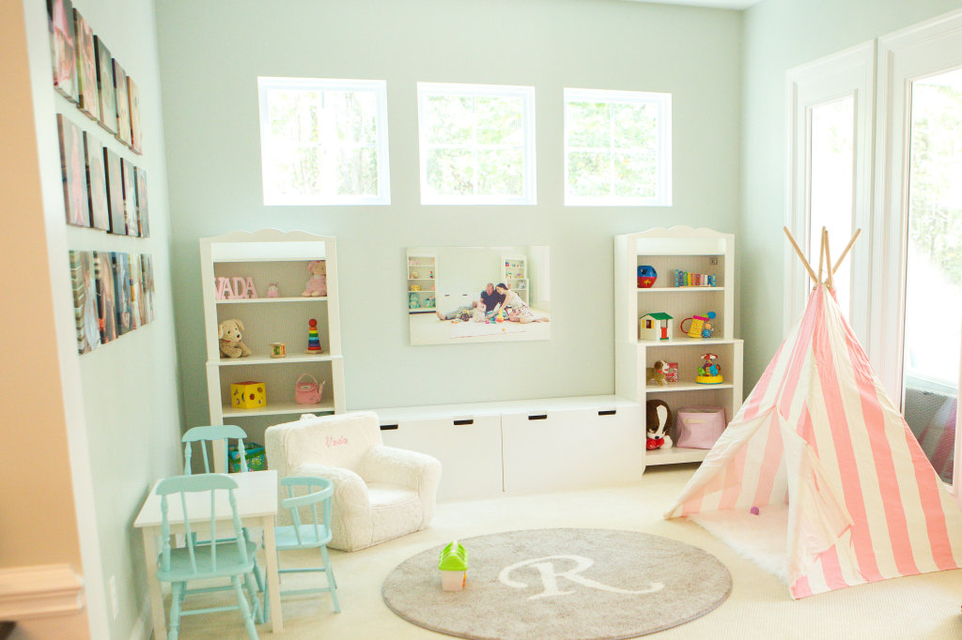
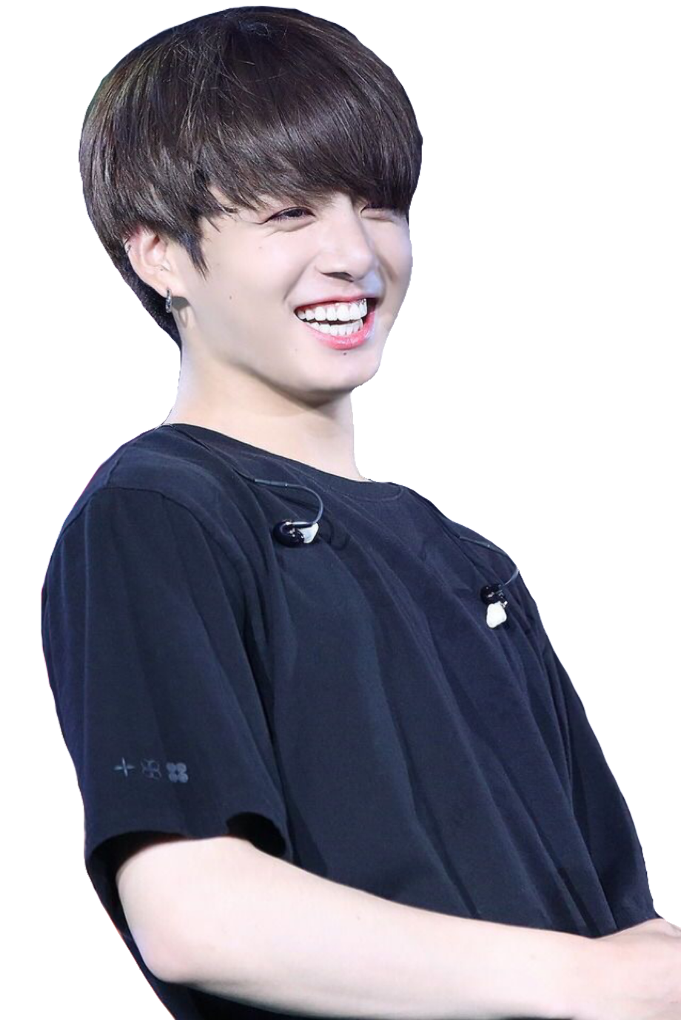
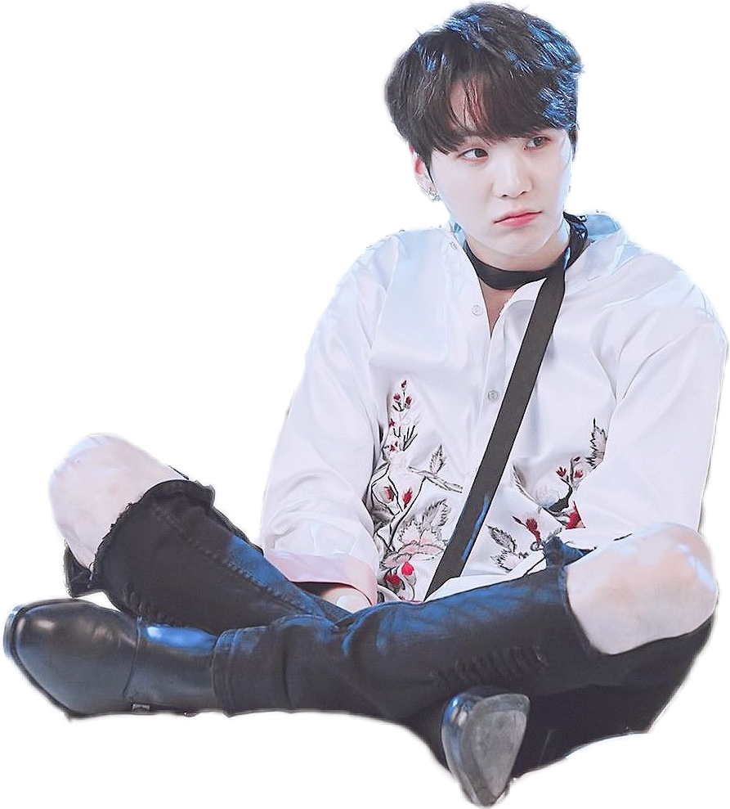
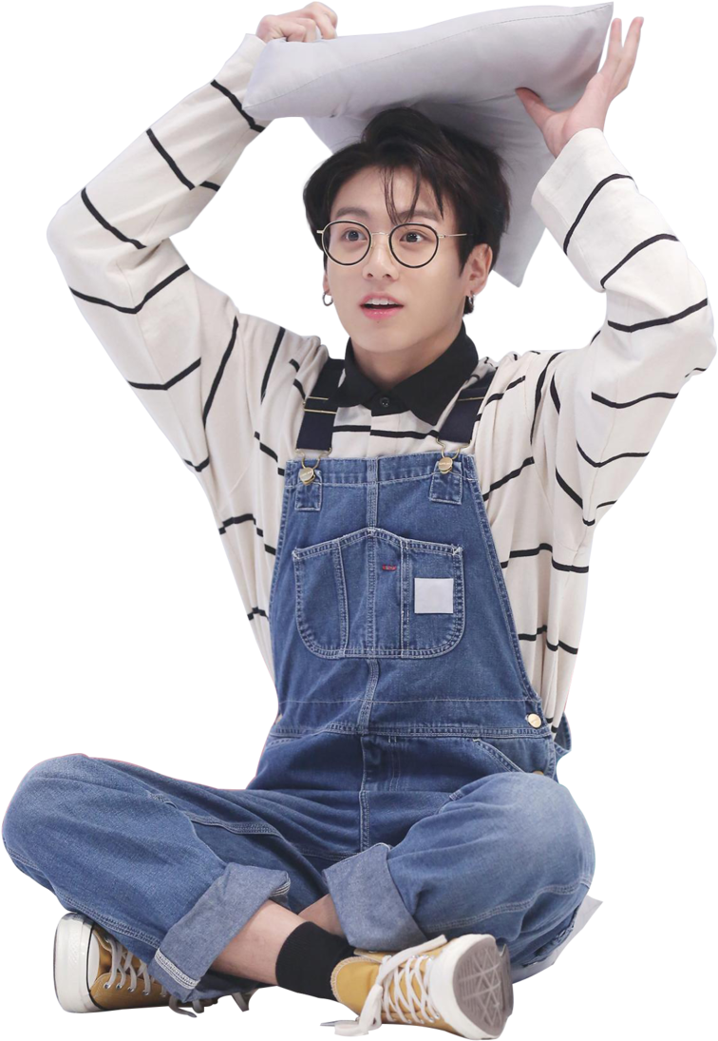
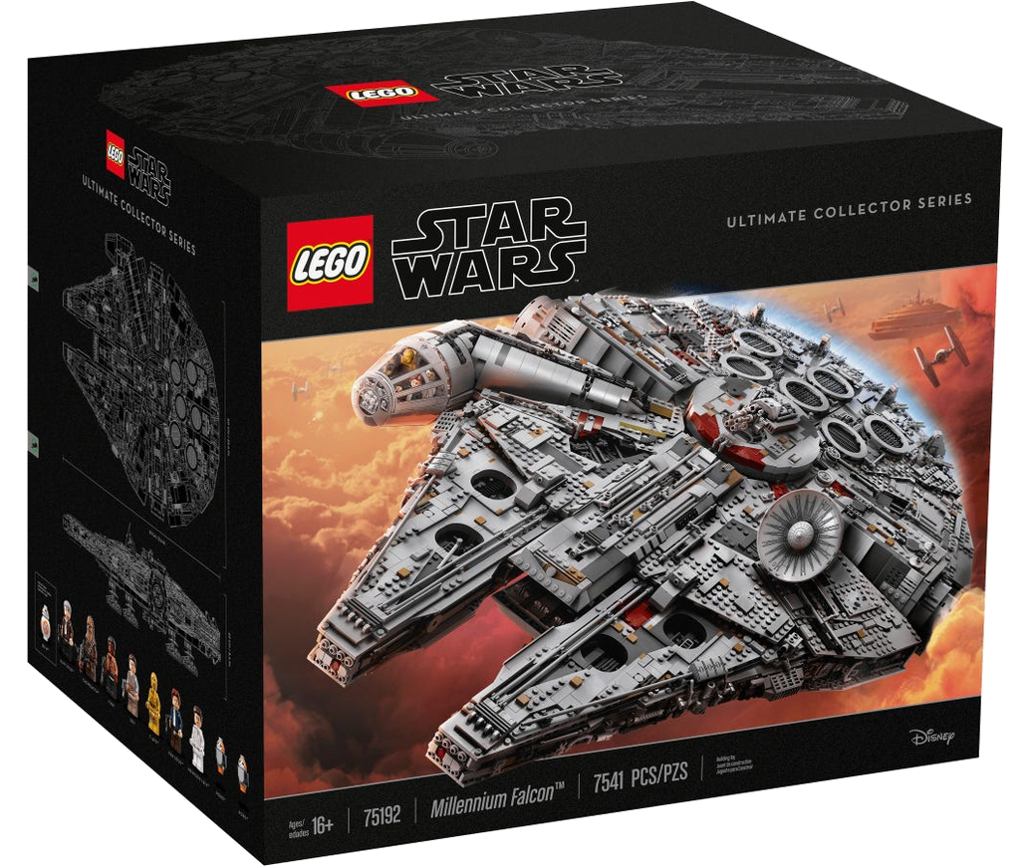

Slide 6
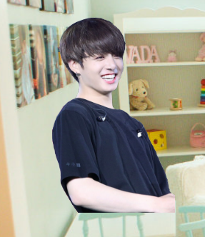
Controller
User

Slide 7
Controller
User
„Build me the lego millenium
falcon!!“
Request

Slide 8
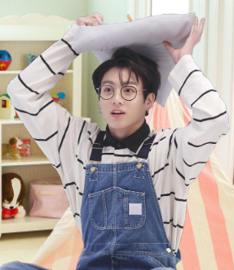
Controller
Model
“Here’s where the fun begins.”
– Han Solo
Request

Slide 9
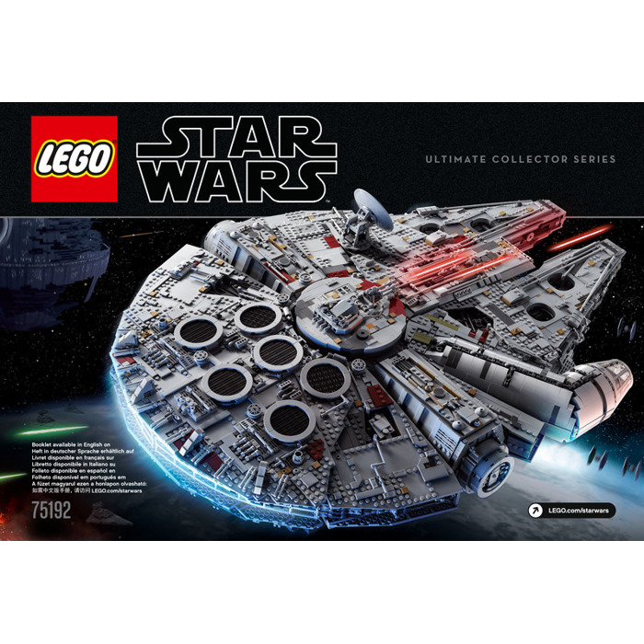
Controller
Model
Data

Slide 10
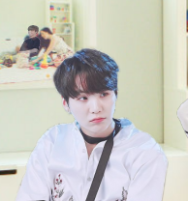
Controller
View
Here’s how the built object
Should look like
Data

Slide 11
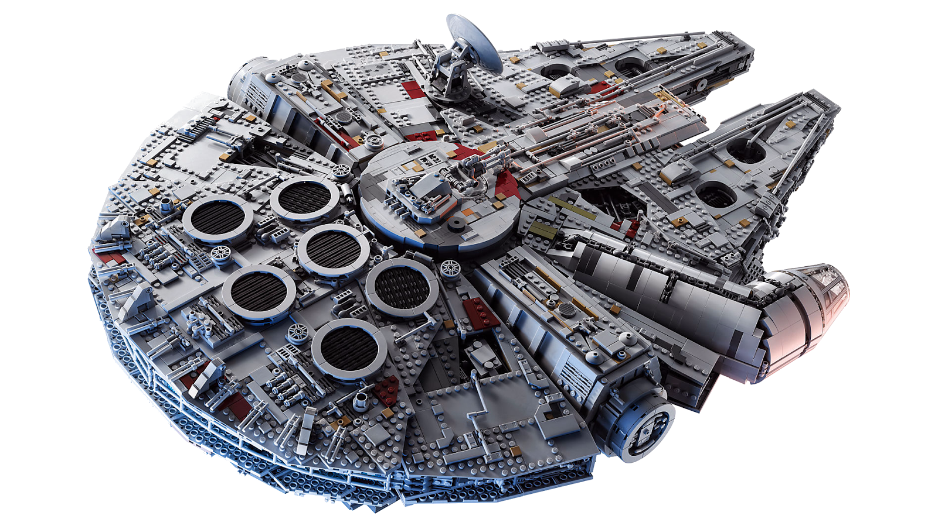
Controller
View
Here you go
Presentation

Slide 12
Controller
User
Response

Slide 13
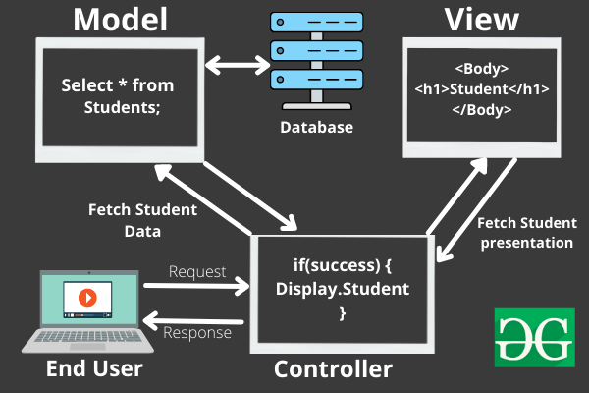

Slide 14



Webframes to consider using

Slide 15
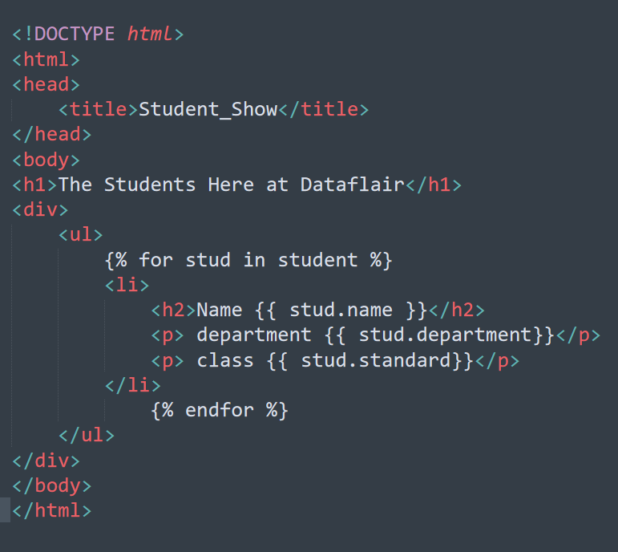
Templates
django

Slide 16
Sources
basic concept
  https://realpython.com/the-model-view-controller-mvc-paradigm-summarized-with-legos/
  https://en.wikipedia.org/wiki/Model%E2%80%93view%E2%80%93controller
  https://www.c-sharpcorner.com/article/what-is-mvc-and-why-we-use-mvc/
cherrypy
  Tutorials
  https://docs.cherrypy.dev/en/latest/tutorials.html#tutorial-1-a-basic-web-application

Slide 17
Sources
baby room - https://projectnursery.com/projects/playroom-pizzazz/
millenium falcon - https://www.lego.com/de-de/product/millennium-falcon-75192
Trygve Reenskaug - https://slides.com/milkokosturkov/gui-architectures-past-present-web
database - http://codingsupply.com/best-programming-projects-college-students/database-icon/
MVC with code - https://www.geeksforgeeks.org/mvc-framework-introduction/
bts suga - https://picsart.com/i/sticker-suga-yoongi-bts-white-milk-cute-boy-kpop-cat-meow-267372967009211
millenium falcon instructions - https://www.google.com/url?sa=i&url=https%3A%2F%2Fwww.brickowl.de%2Fcatalog%2Flego-millennium-falcon-set-75192-instructions&psig=AOvVaw3nAYkhUhQiONWM50V4Bsth&ust=1667742981236000&source=images&cd=vfe&ved=0CAoQjRxqFwoTCMC2wsuZl_sCFQAAAAAdAAAAABAb
CherryPy - http://kb-docs-archive.librato.com/collect/integrations/cherrypy/
Sqlite - https://logospng.org/logo-sqlite/
Django - https://se.ewi.tudelft.nl/desosa2019/chapters/django/
CubicWeb - https://www.tivix.com/blog/python-frameworks

Slide 18
Thank you!
No BTS members were harmed during the making of this presentation

